Slide 1
Observations from Europe
CCRA ”Trashforce” Presentation
December 14, 2021

Slide 2
Cities and Regions Visited
Brussels Belgium
Amsterdam, Netherlands
Rennes, France
Paris, France
Carqueiranne, Cōte D’Azur/Var, France

Slide 3
Brussels, Belgium
Nation’s Capital; Headquarters of European Union
One of Three Autonomous Regions in Belgian Kingdom
Decentralized Governance – Local Municipalities, City Halls
Twice Weekly Household General Trash Pickup
Color coded regulation bags sold in groceries
Segregation of Recyclables by Category– 1x week pickup
Abundant Containers in Parks and Squares
Evidence of Video Monitoring – Less than 100% Compliance

Slide 4
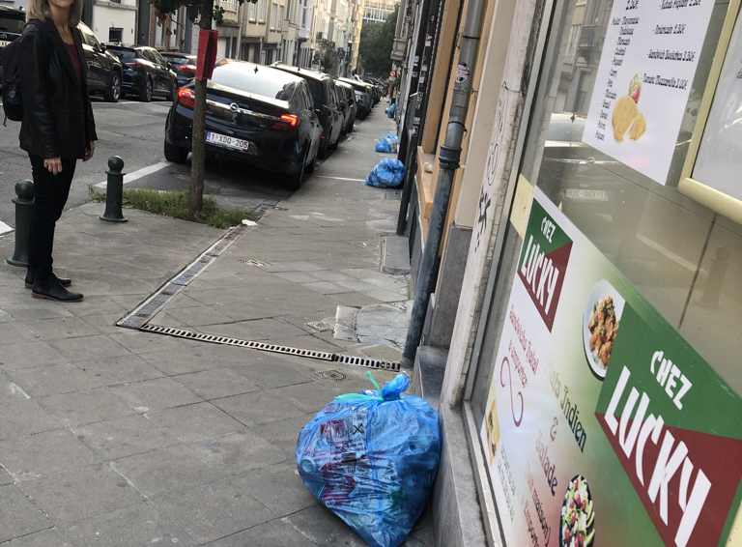
Regulation biodegradable bags– frequent pickup
z

Slide 6
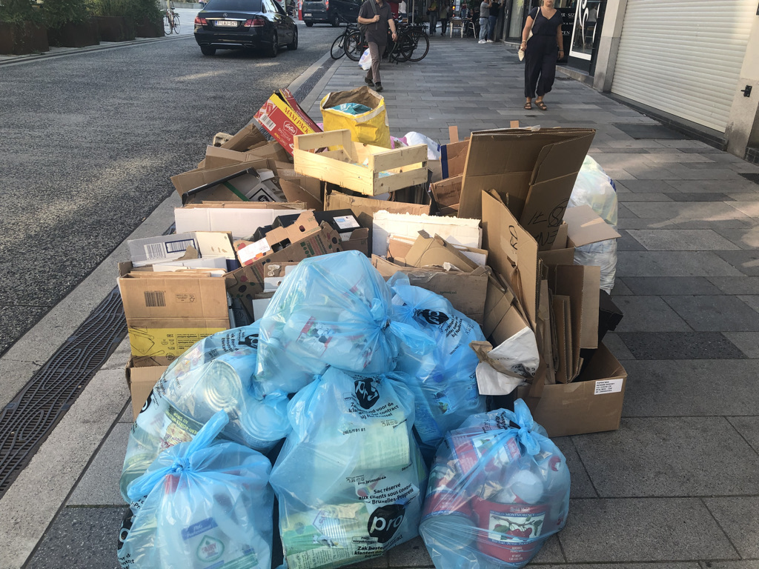
Brussels–still gotta long way to go
z

Slide 7
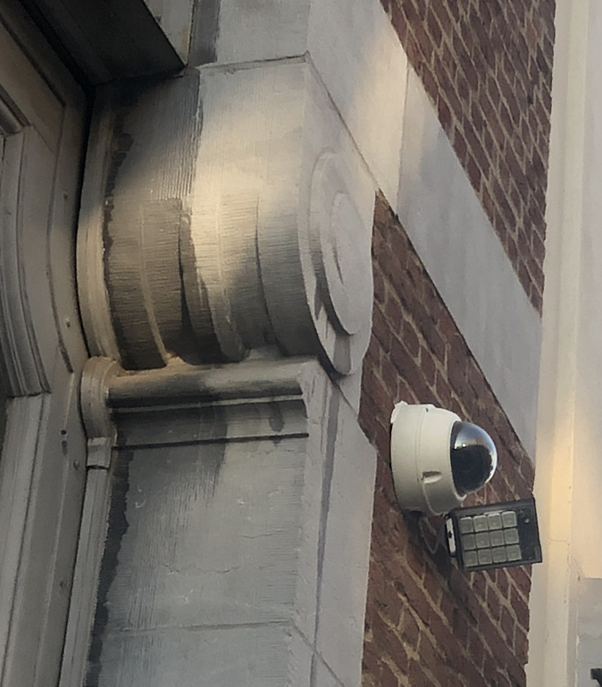
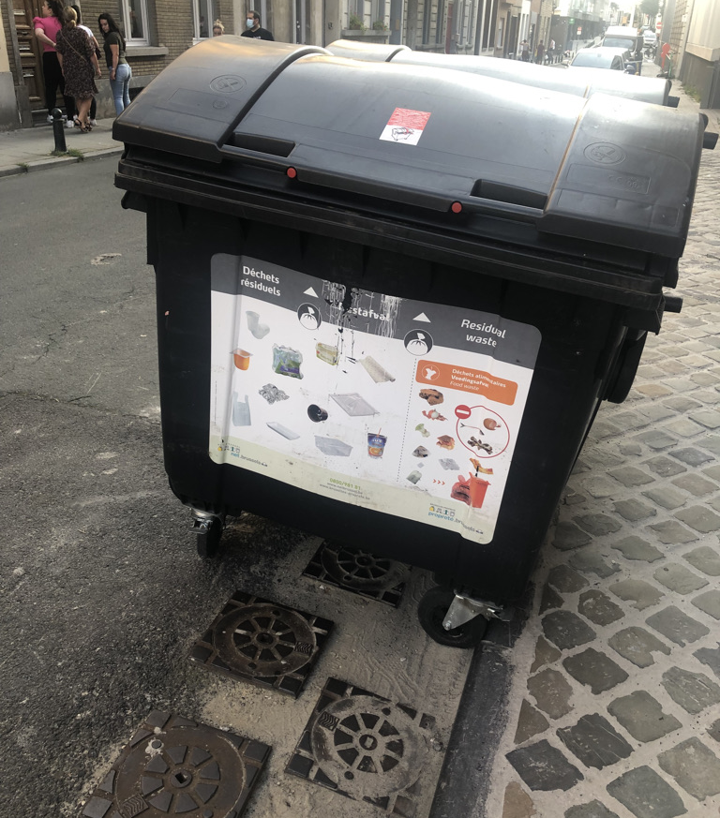
Street containers with video enforcement of rules against short dumping
z

Slide 8
Amsterdam, Netherlands
Business Center/ Nation’s Capital (shared with the Hague)
Relatively Compact size; Centralized Administration/at large council by proportional representation
All waste must be put in established containers, emptied by City
Trash must be segregated by type
Ubiquitous containers in pedestrian areas for street trash
Frequent street sweeping and cleaning

Slide 9
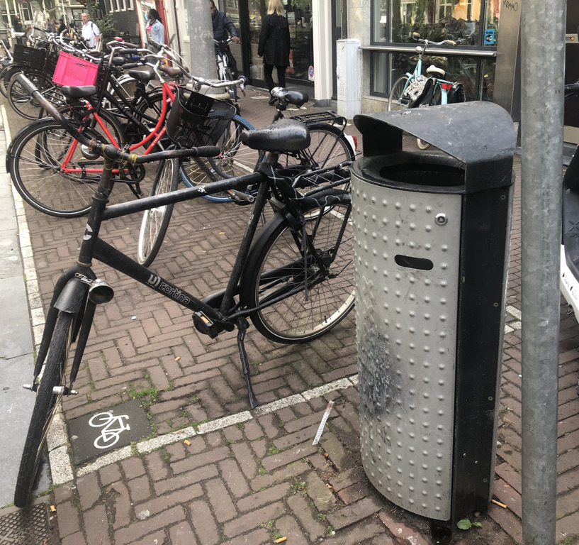
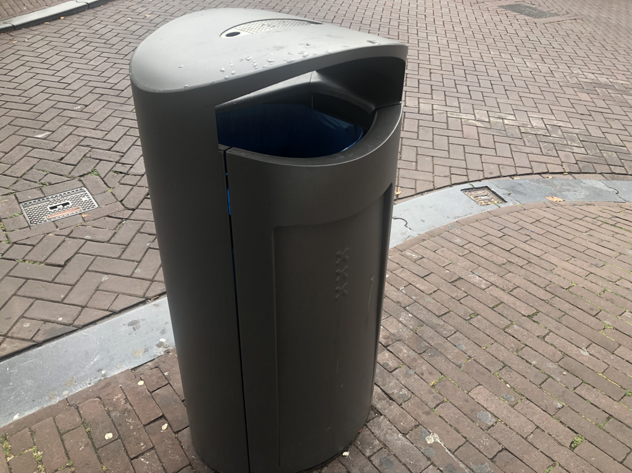
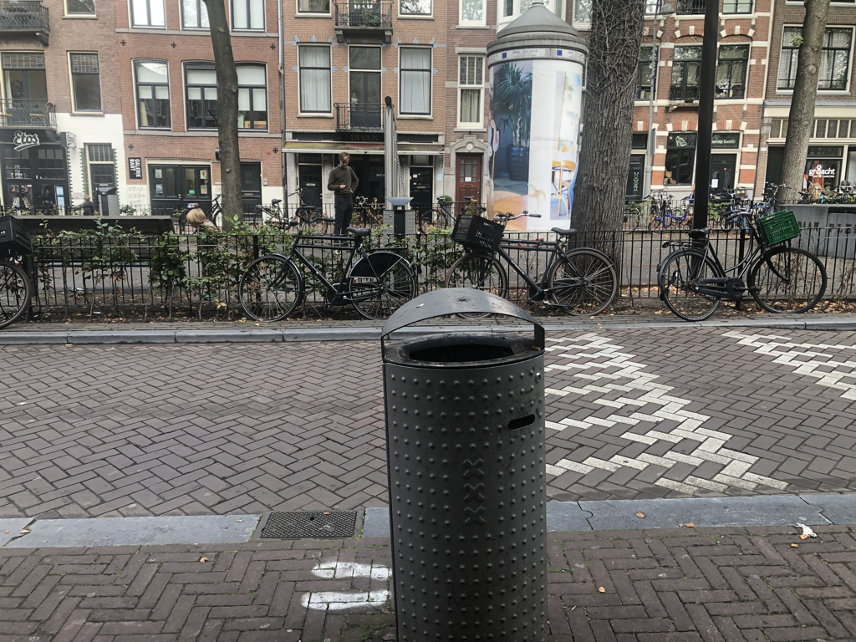
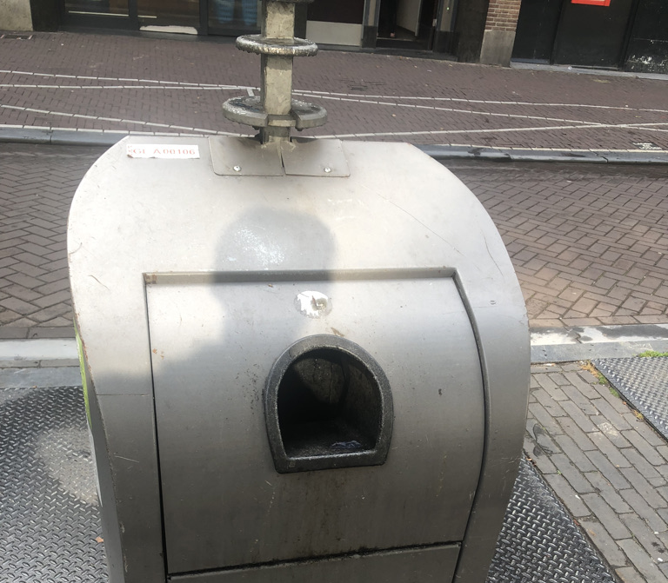
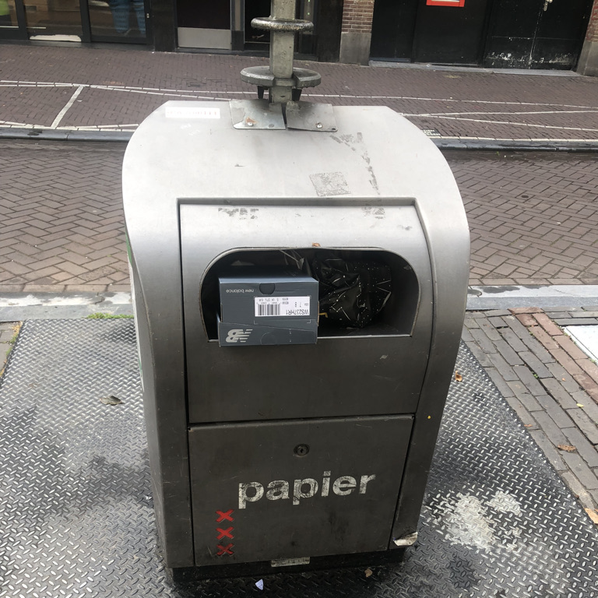

Slide 10
Rennes France
Regional Capital – Bretagne
Trash must be brought to established outdoor containers
Green containers for general household trash are reserved for residents– can be asked for proof
Large variety of types of containers visible, many highly engineered

Slide 11
Big capacity bins- Can be loaded on a truck
z

Slide 12
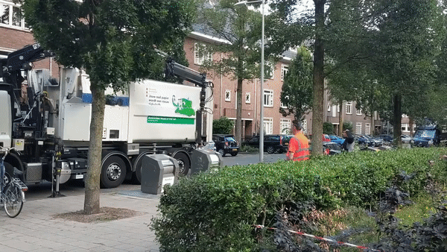
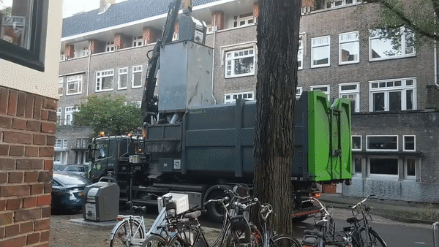

Slide 13
Paris, France
National Capital
Decentralized Administration, 20 city halls (arrondissements) with separate administration of local matters including trash
Approximately ½ collected by City (Dept of Water), ½ by private haulers in contract with City Halls
Daily collection of household waste from green-lid containers
Twice-weekly collection of other types of recyclables
Many self-serve recycling containers in parks
Variety of containers for street trash in pedestrian areas

Slide 14
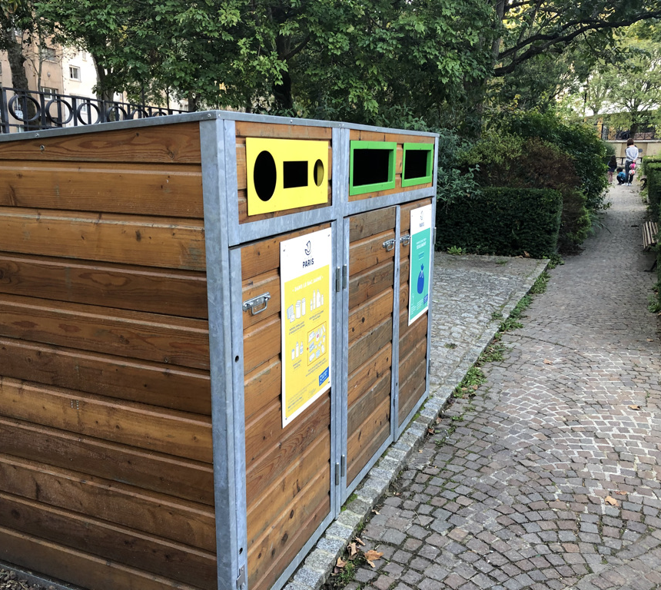
Parks
z
Animal resistant containers for park users
Recycling containers for local residents

Slide 15
Containers ready for emptying— Trucks arrive every day
z

Slide 16
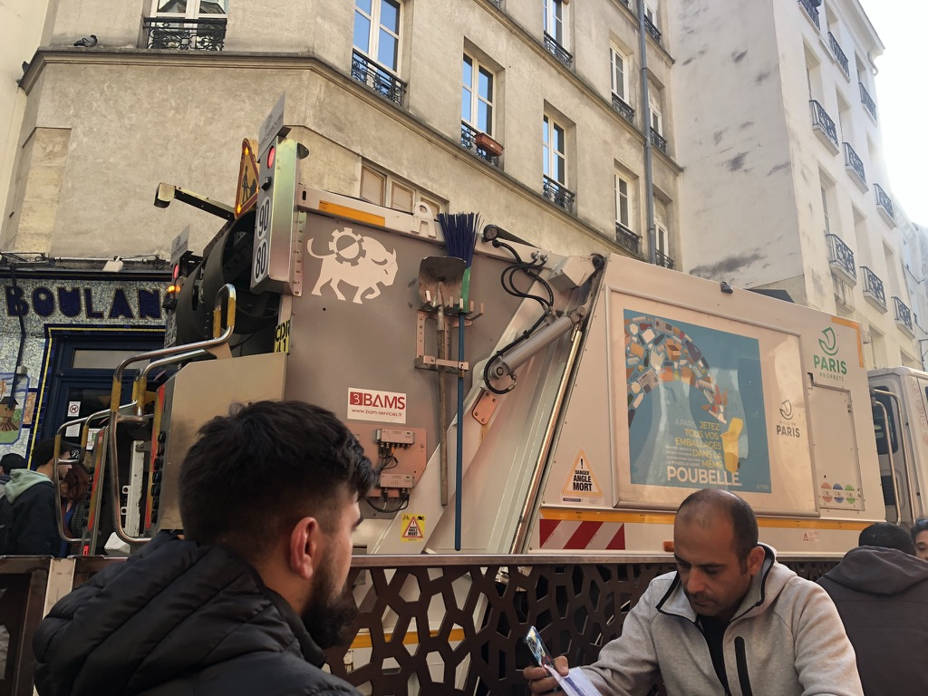
Automated Trucks– various sizes
z

Slide 17
Simple Design for Pedestrian Trash

Slide 18
Cote D’Azur/ Var
Densely settled, variety of medium-sized and small towns
Each municipality has authority but are subject to regulation and elect to cooperate: ”Inter-communal” (e.g. Carqueirrane trash is managed by “Metropole Toulon Provence Méditerranée”
Standard street containers

Slide 19
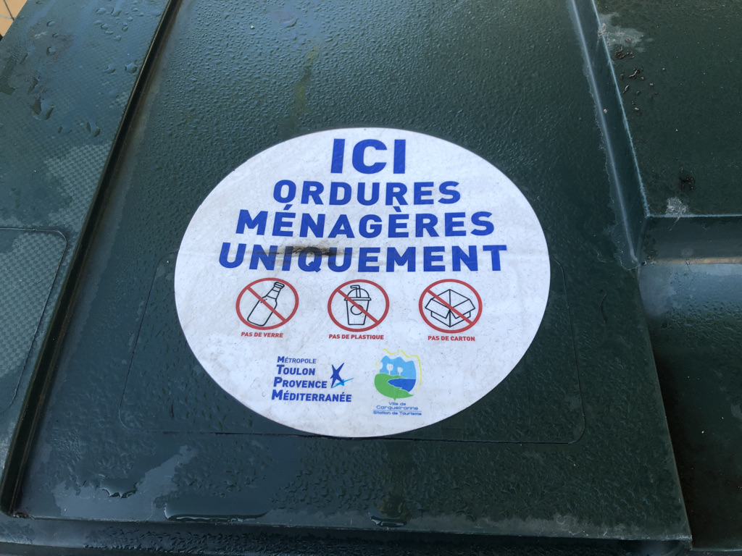
Mobile Containers – policies posted
z

Slide 20
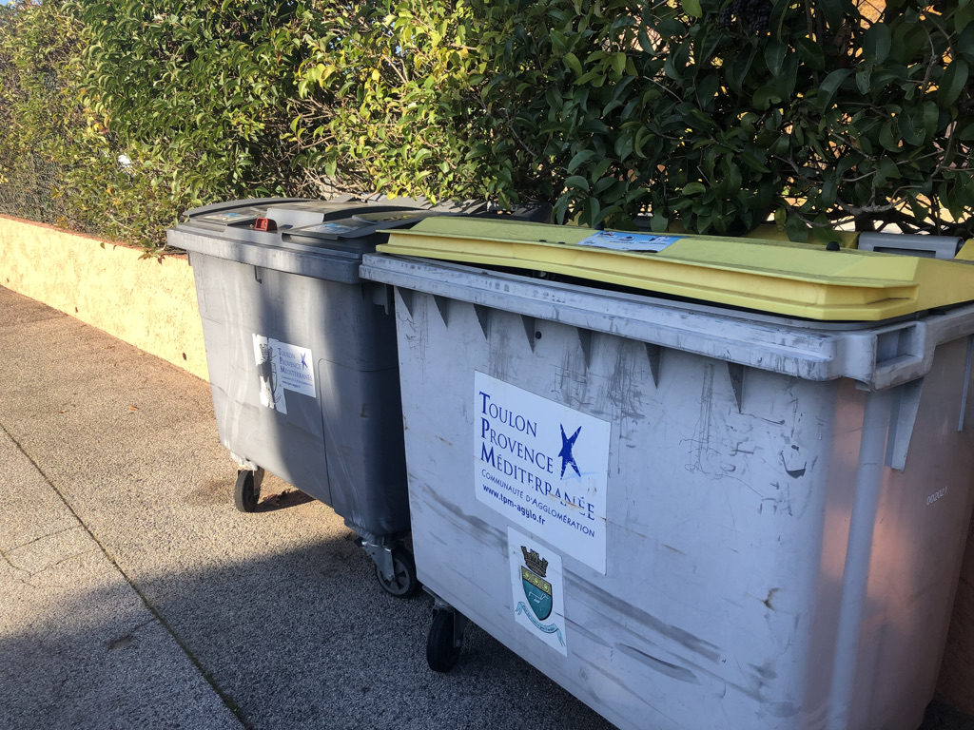
Green lids and yellow lids; grey ones too
z

