Slide 1
The People Powered Voice for a Better Community
DIVERSITY, EQUITY, INCLUSION AND JUSTICE COMMITTEE
Maggie Mund, Chair
Jared Gluskin
Barbara Halpern
Ryan Muholland
Travis Oliver, Managing Director
Rick Speizmann
BOARD REPORT: 12/14/2021

Slide 2
What does CCRA’s emphasis on DEIJ mean?
The purpose of CCRA’s DEIJ committee is to explore ways that CCRA can provide meaningful voice and opportunities for those who have not equally enjoyed the benefits our community has experienced, including broader representation on our board and partnering with social justice organizations to implement change.
DIVERSITY, EQUITY, INCLUSION AND JUSTICE COMMITTEE
BOARD REPORT: 12/14/2021

Slide 3
Why DEIJ and CCRA Now?
Anti-Black racism is manifested in the current social, economic and political marginalization of Black people in society, such as the lack of opportunities, lower socioeconomic status, higher unemployment, significant poverty rates and overrepresentation in the criminal justice system.
It is important to address anti-Black racism because it is the root cause for the racial inequity we see today.
DIVERSITY, EQUITY, INCLUSION AND JUSTICE COMMITTEE
BOARD REPORT: 12/14/2021

Slide 4
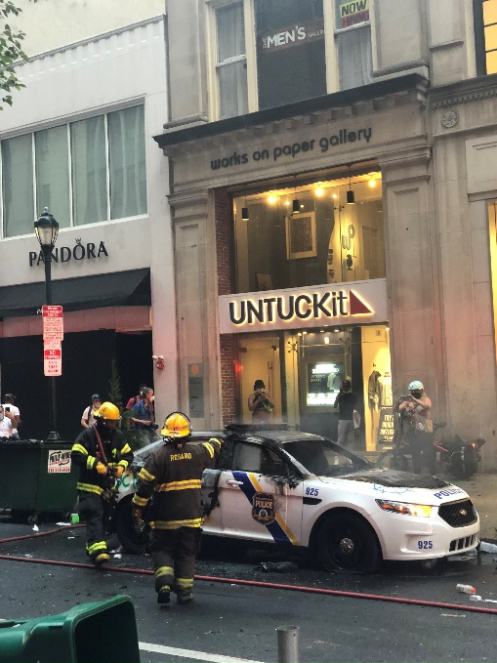
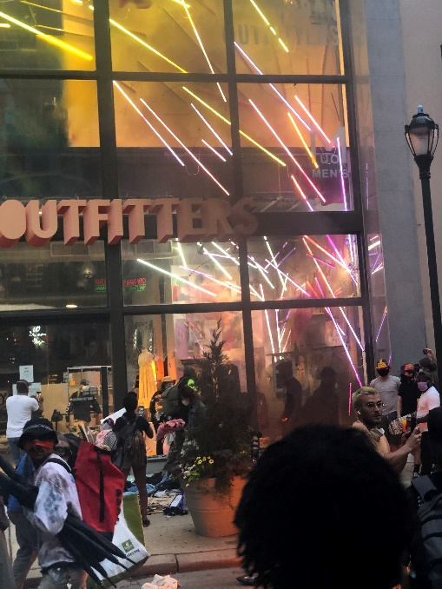
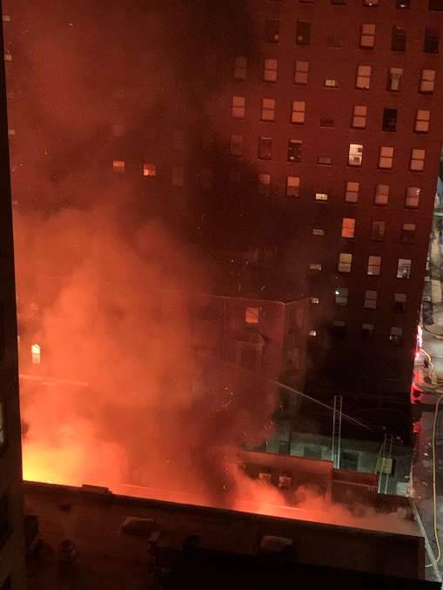
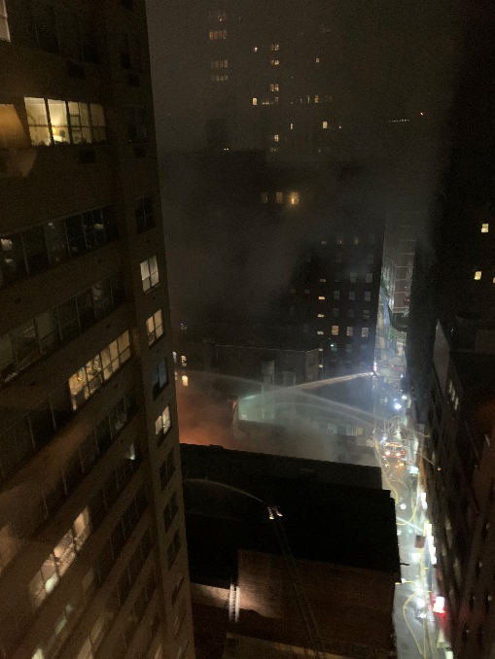
Why CCRA and DEIJ Now?
DIVERSITY, EQUITY, INCLUSION AND JUSTICE COMMITTEE
BOARD REPORT: 12/14/2021

Slide 5
CCRA Principles for DEIJ
Integrate DEIJ concerns into CCRA board and committees
Partner with well known and experienced social justice organizations
Increases our reach
Establishes credibility
Reduces stress on CCRA volunteers
All actions must be in accordance with CCRA’s Mission
DIVERSITY, EQUITY, INCLUSION AND JUSTICE COMMITTEE
BOARD REPORT: 12/14/2021

Slide 6
CCRA Mission Statement
Serving as the voice of Center City West since 1947, The Center City Residents’ Association (CCRA)
promotes urban living;
advocates for a safe, clean, diverse, and supportive community;
pursues accountability; and
encourages responsible development while preserving the neighborhood's historic heritage.
DIVERSITY, EQUITY, INCLUSION AND JUSTICE COMMITTEE
BOARD REPORT: 12/14/2021

Slide 7
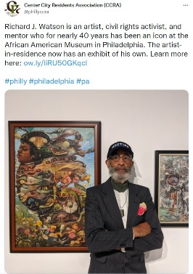
Promotional
Sharing events promoted by social justice organizations via our social media, CCQ and CCRA This Week increases their visibility and reach.
Sample CCRA Tweets
DIVERSITY, EQUITY, INCLUSION AND JUSTICE COMMITTEE
BOARD REPORT: 12/14/2021

Slide 8
Educational
Sense in the City – a CCRA winter 2022 Zoom discussion series led by Hugh Taft Morales of the Philadelphia Ethical Society
A series of conversations about community, difference, power, and justice in Center City.
Potential Topics
Homelessness
Gun violence
Improving schools
Climate justice
Economic inequality
Public health
Supporting local entrepreneurs and minority owned businesses.
DIVERSITY, EQUITY, INCLUSION AND JUSTICE COMMITTEE
BOARD REPORT: 12/14/2021

Slide 9
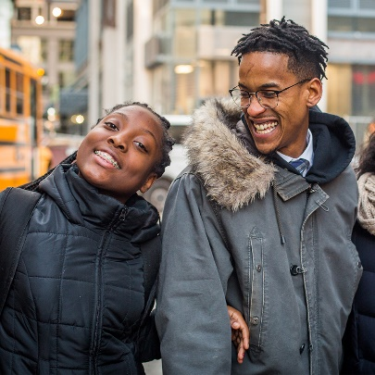
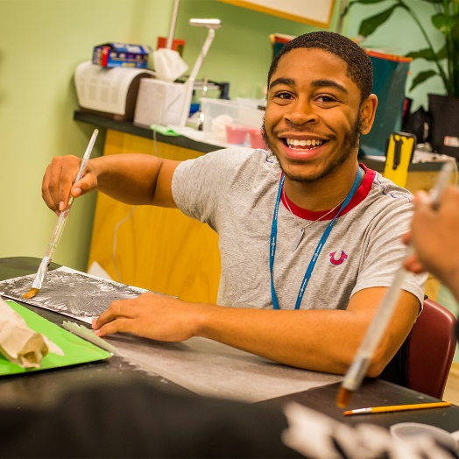
Advocacy
Friere Charter School Support Partnership
Work with Freire Charter School administrators and students to provide opportunities for internships, training, and mentoring from CCRA members
DIVERSITY, EQUITY, INCLUSION AND JUSTICE COMMITTEE
BOARD REPORT: 12/14/2021

Slide 10
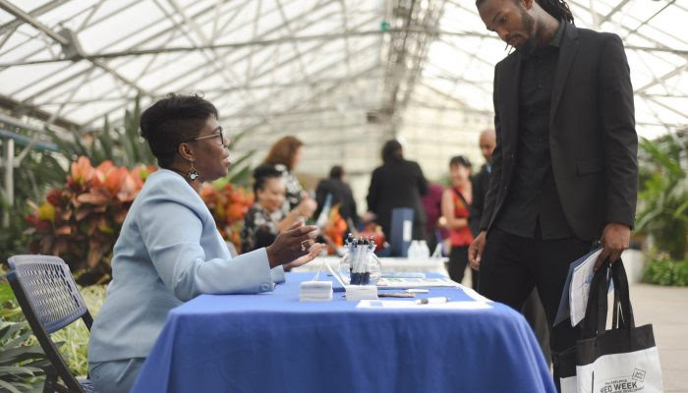
Advocacy
CCRA Small Business Investment Fund
Provide low-interest loans and social capital to qualified, under-resourced entrepreneurs in order to co-create a more equitable, compassionate, sustainable, and vibrant local economy in Center City.
Potential Partners
include
The Enterprise Center
The African American Chamber of Commerce
Urban Affairs Coalition
The Philadelphia Foundation
DIVERSITY, EQUITY, INCLUSION AND JUSTICE COMMITTEE
BOARD REPORT: 12/14/2021

Slide 11
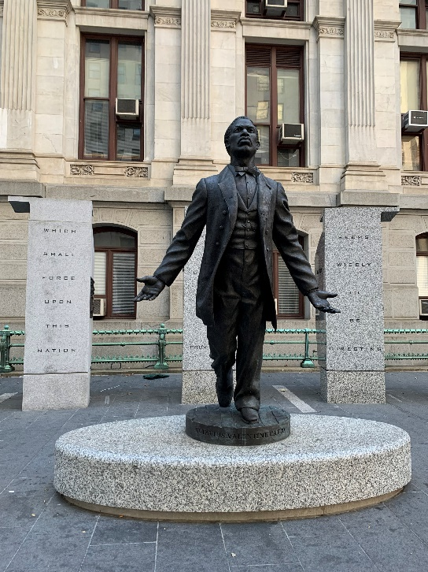
Why Now?
“Two hundred fifty
years of slavery.
Ninety years of Jim
Crow.
Sixty years of separate
but equal
Thirty-five years of racist housing policy.
Until we reckon with our compounding moral debts, America will never be whole.”
Ta-Nehisi Coates
DIVERSITY, EQUITY, INCLUSION AND JUSTICE COMMITTEE
BOARD REPORT: 12/14/2021

Slide 12
Implementation Steps
1. CCRA Social Media Promotions
2. Sense in the City – a Zoom discussion series in partnership with the Philadelphia Ethical Society
Partnership with the Freire Charter School
CCRA Small Business Investment Fund
DIVERSITY, EQUITY, INCLUSION AND JUSTICE COMMITTEE
BOARD REPORT: 12/14/2021

Slide 13
The People Powered Voice for a Better Community
DIVERSITY, EQUITY, INCLUSION AND JUSTICE COMMITTEE
BOARD REPORT: 12/14/2021
RESOLUTION OF SUPPORT
THAT CCRA CONTINUE TO ADVANCE THE DEIJ AGENDA PRESENTED ON 12/14/2021

